Slide 1


Premium Venue for Collectors, Conferences & Celebrations
Founded 2025 | Riyadh, Saudi Arabia

Slide 2

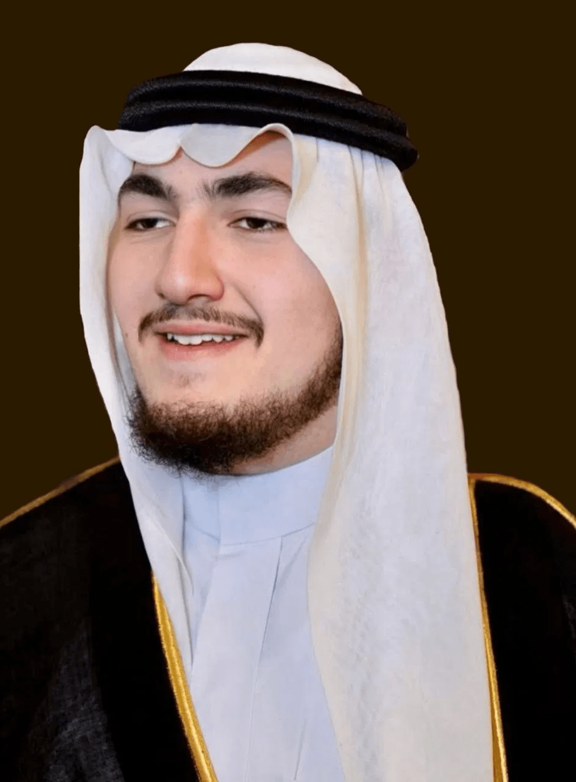
Chairman of the Board
HRH Prince Meshhour bin Talal bin Abdulaziz Al Saud
Leadership Excellence & Strategic Vision
His Royal Highness Prince Meshhour brings distinguished leadership and extensive personal collecting experience to guide the strategic vision of Dunes Gate. With a deep commitment to preserving cultural heritage and fostering community engagement, he ensures the venue meets the highest standards of prestige and excellence.
"
Dunes Gate represents more than a venue—it is a sanctuary for passion, a platform for excellence, and a bridge connecting collectors, and communities.
— HRH Prince Meshhour Bin Talal
DUNES GATE

Slide 3

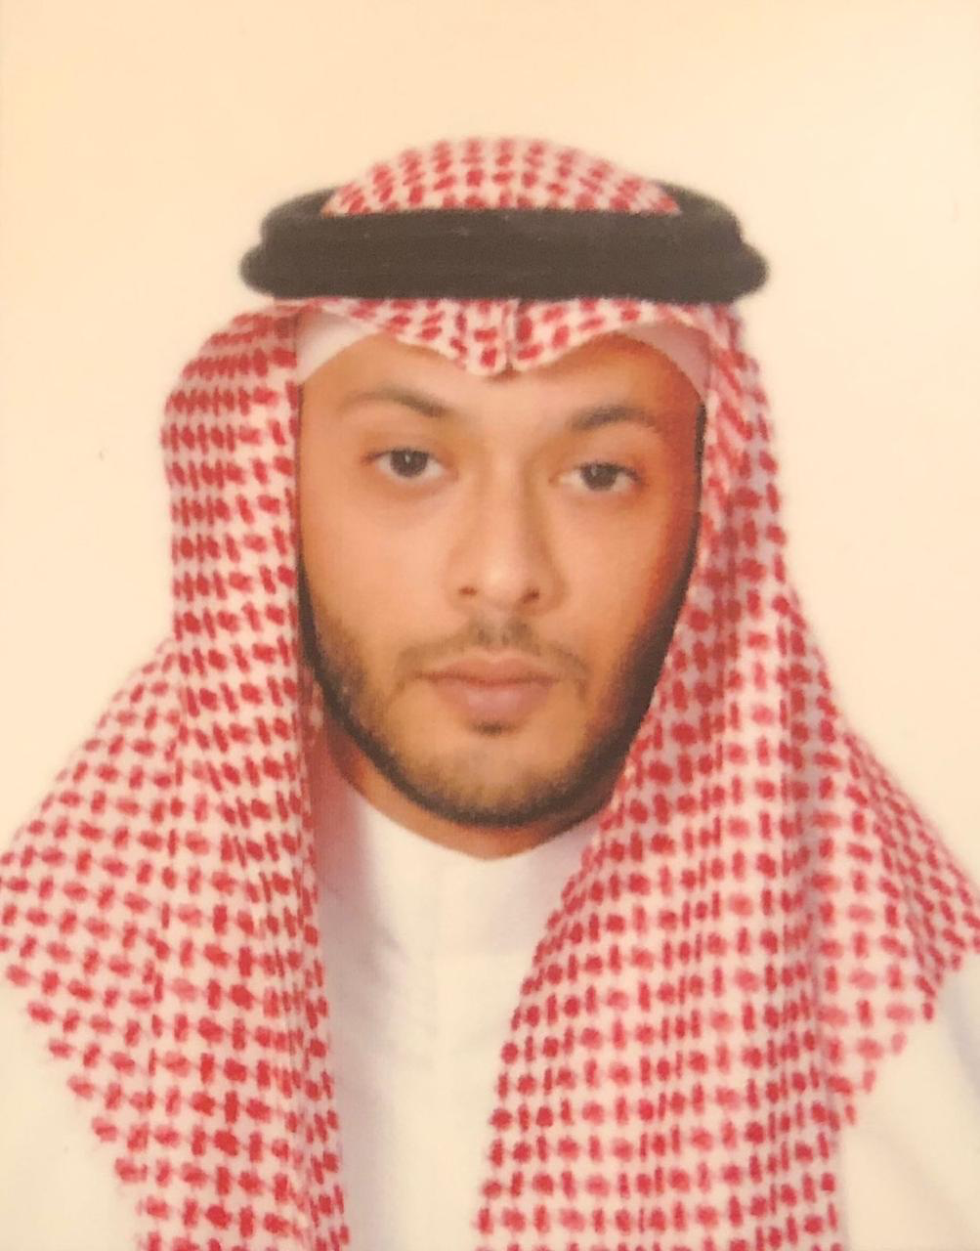
Board Member & General Manager
Mr. Youssef Ibrahim Hamidaddin
Strategic Leadership & International Collaboration
Mr. Youssef Ibrahim Hamidaddin leads the strategic operations and partnerships that elevate Dunes Gate's standing in the regional and international event venue landscape. With deep expertise in collection management, market dynamics, and operational excellence, he ensures seamless execution across all events.
Our role is to transform visions into reality. Through careful planning, strategic execution, and a culture of excellence, we ensure that Dunes Gate becomes the trusted partner for every significant event—whether it's a conference, exhibition, or celebration."
"
— Mr. Youssef Ibrahim Hamidaddin
DUNES GATE

Slide 4

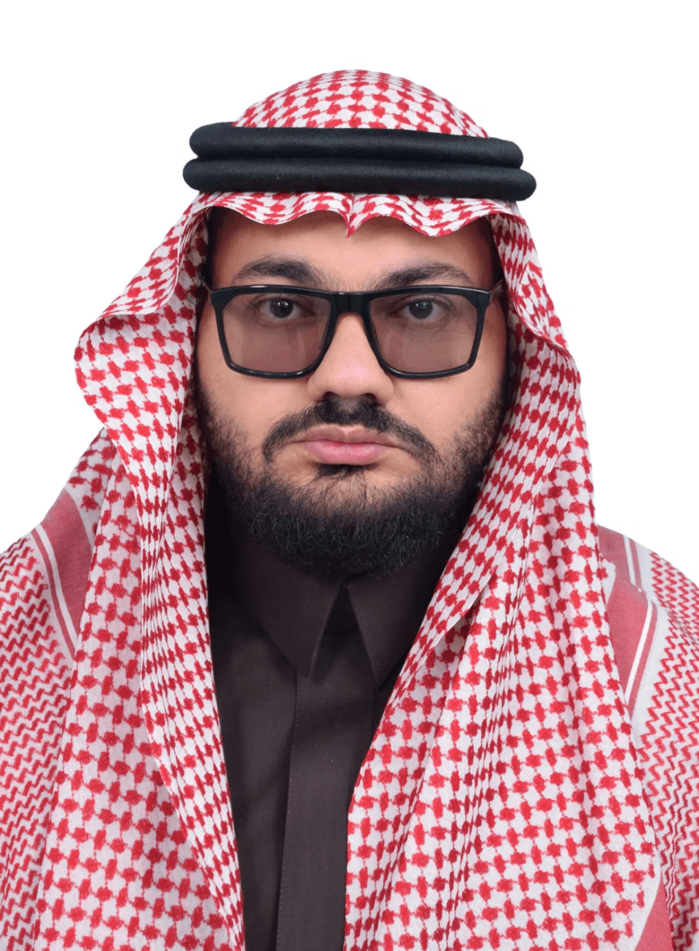
Board Member
Mr. Mohannad Atif Saleh
Operational Excellence & Strategic Partnerships
Mr. Mohannad Atif Saleh leads the strategic operations and partnerships that elevate Dunes Gate's standing in the regional and international event venue landscape. With deep expertise in collection management, market dynamics, and operational excellence, he ensures seamless execution across all events.
"
By connecting cultures and communities through shared passions, we create opportunities for growth, understanding, and lasting relationships.
— Mr. Mohannad Atif Saleh
DUNES GATE

Slide 5





Our Vision & Mission
A Premier Destination for Diverse Events and Experiences
Key Positioning
Dunes Gate was established in 2025 as a visionary project dedicated to creating a world-class event venue that serves the diverse needs of Riyadh's dynamic community. We recognize that modern event venues must be versatile, secure, and beautifully designed.
Premium Adaptability
Riyadh's most versatile premium event venue, adaptable for any scale or style.
Multi-Purpose Design
Expertly designed for collectors, conferences, exhibitions, and celebrations.
Our Mission
Service Excellence
Unwavering commitment to professional service and operational perfection.
"To provide an elegant, professionally managed space where VIPs, collectors, businesses, cultural organizations, and families can celebrate their passions and achieve their goals."
Strategic Location
Prime positioning in the heart of Riyadh, connecting culture and commerce.
DUNES GATE

Slide 6


Our Team: Management
Leadership by Visionaries, For Excellence
Mr. Hadi A. Farid
!@#$%^&
Mr. Abdullah Badawi
Operation Lead
#$%^&*(
Marketing & Media Lead
"Overseeing all operational aspects of Dunes Gate from venue development through execution. With expertise spanning infrastructure management and daily operations, he ensures seamless coordination of all venue functions while maintaining the highest standards of service delivery and operational efficiency."
We we wwew
"Leading Dunes Gate's Marketing and Media vision to position the venue as a premier event destination. Drawing on deep expertise in brand development and market strategy, he orchestrates marketing campaigns that showcase the venue's capabilities and drive sustainable growth.".
Collective Commitment
"United by a dedication to excellence and a personal commitment to serving the community with professionalism and integrity."

Slide 7


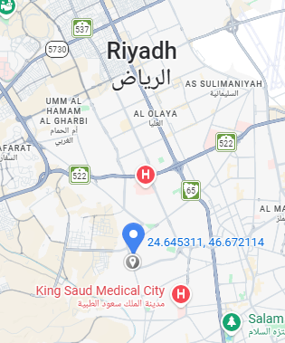




Strategic Location & Accessibility
Prime Riyadh Location with Unmatched Accessibility
Community Integration
Market Position
Positioned strategically in the heart of Riyadh, Dunes Gate offers prestige, accessibility, and a direct connection to the city's vibrant culture and business community. Our location is chosen to serve both local and regional audiences effectively.
Venue Location:
Location Advantages:
Central Riyadh Positioning
Easy access from all city districts, minimizing travel time for guests.
Entertainment District Connection
Integrated with Riyadh's growing events and cultural landscape.
Excellent Connectivity
Direct access to major arterial roads and public transportation networks.
Sufficient Parking Space
Dedicated parking zones ensuring convenient vehicle access for attendees.

Slide 8

Venue Overview & Capacity
Comprehensive Facilities Designed for Every Type of Event
15,000 sqm
Capacity
The venue can be configured for large-scale exhibitions, intimate gatherings, or multi-session conferences that can hold up to @#$%&&* people at once but can be tailored based on the client’s needs.
Total Venue Area
3,550 sqm
620 sqm
Main Event Hall
Separate VIP Venue
210 sqm
3
Flexible Configuration System
Registration / Reception Hangar
Dedicated Meeting/Media Rooms
Our organized grid system maximizes accessibility while maintaining privacy for each event setup. The venue can be configured for large-scale exhibitions, intimate gatherings, or multi-session conferences simultaneously, ensuring a tailored experience for every client.
Dedicated
Ample
Parking Space that fits up to 450 Cars
Outdoor Landscaping

Slide 9

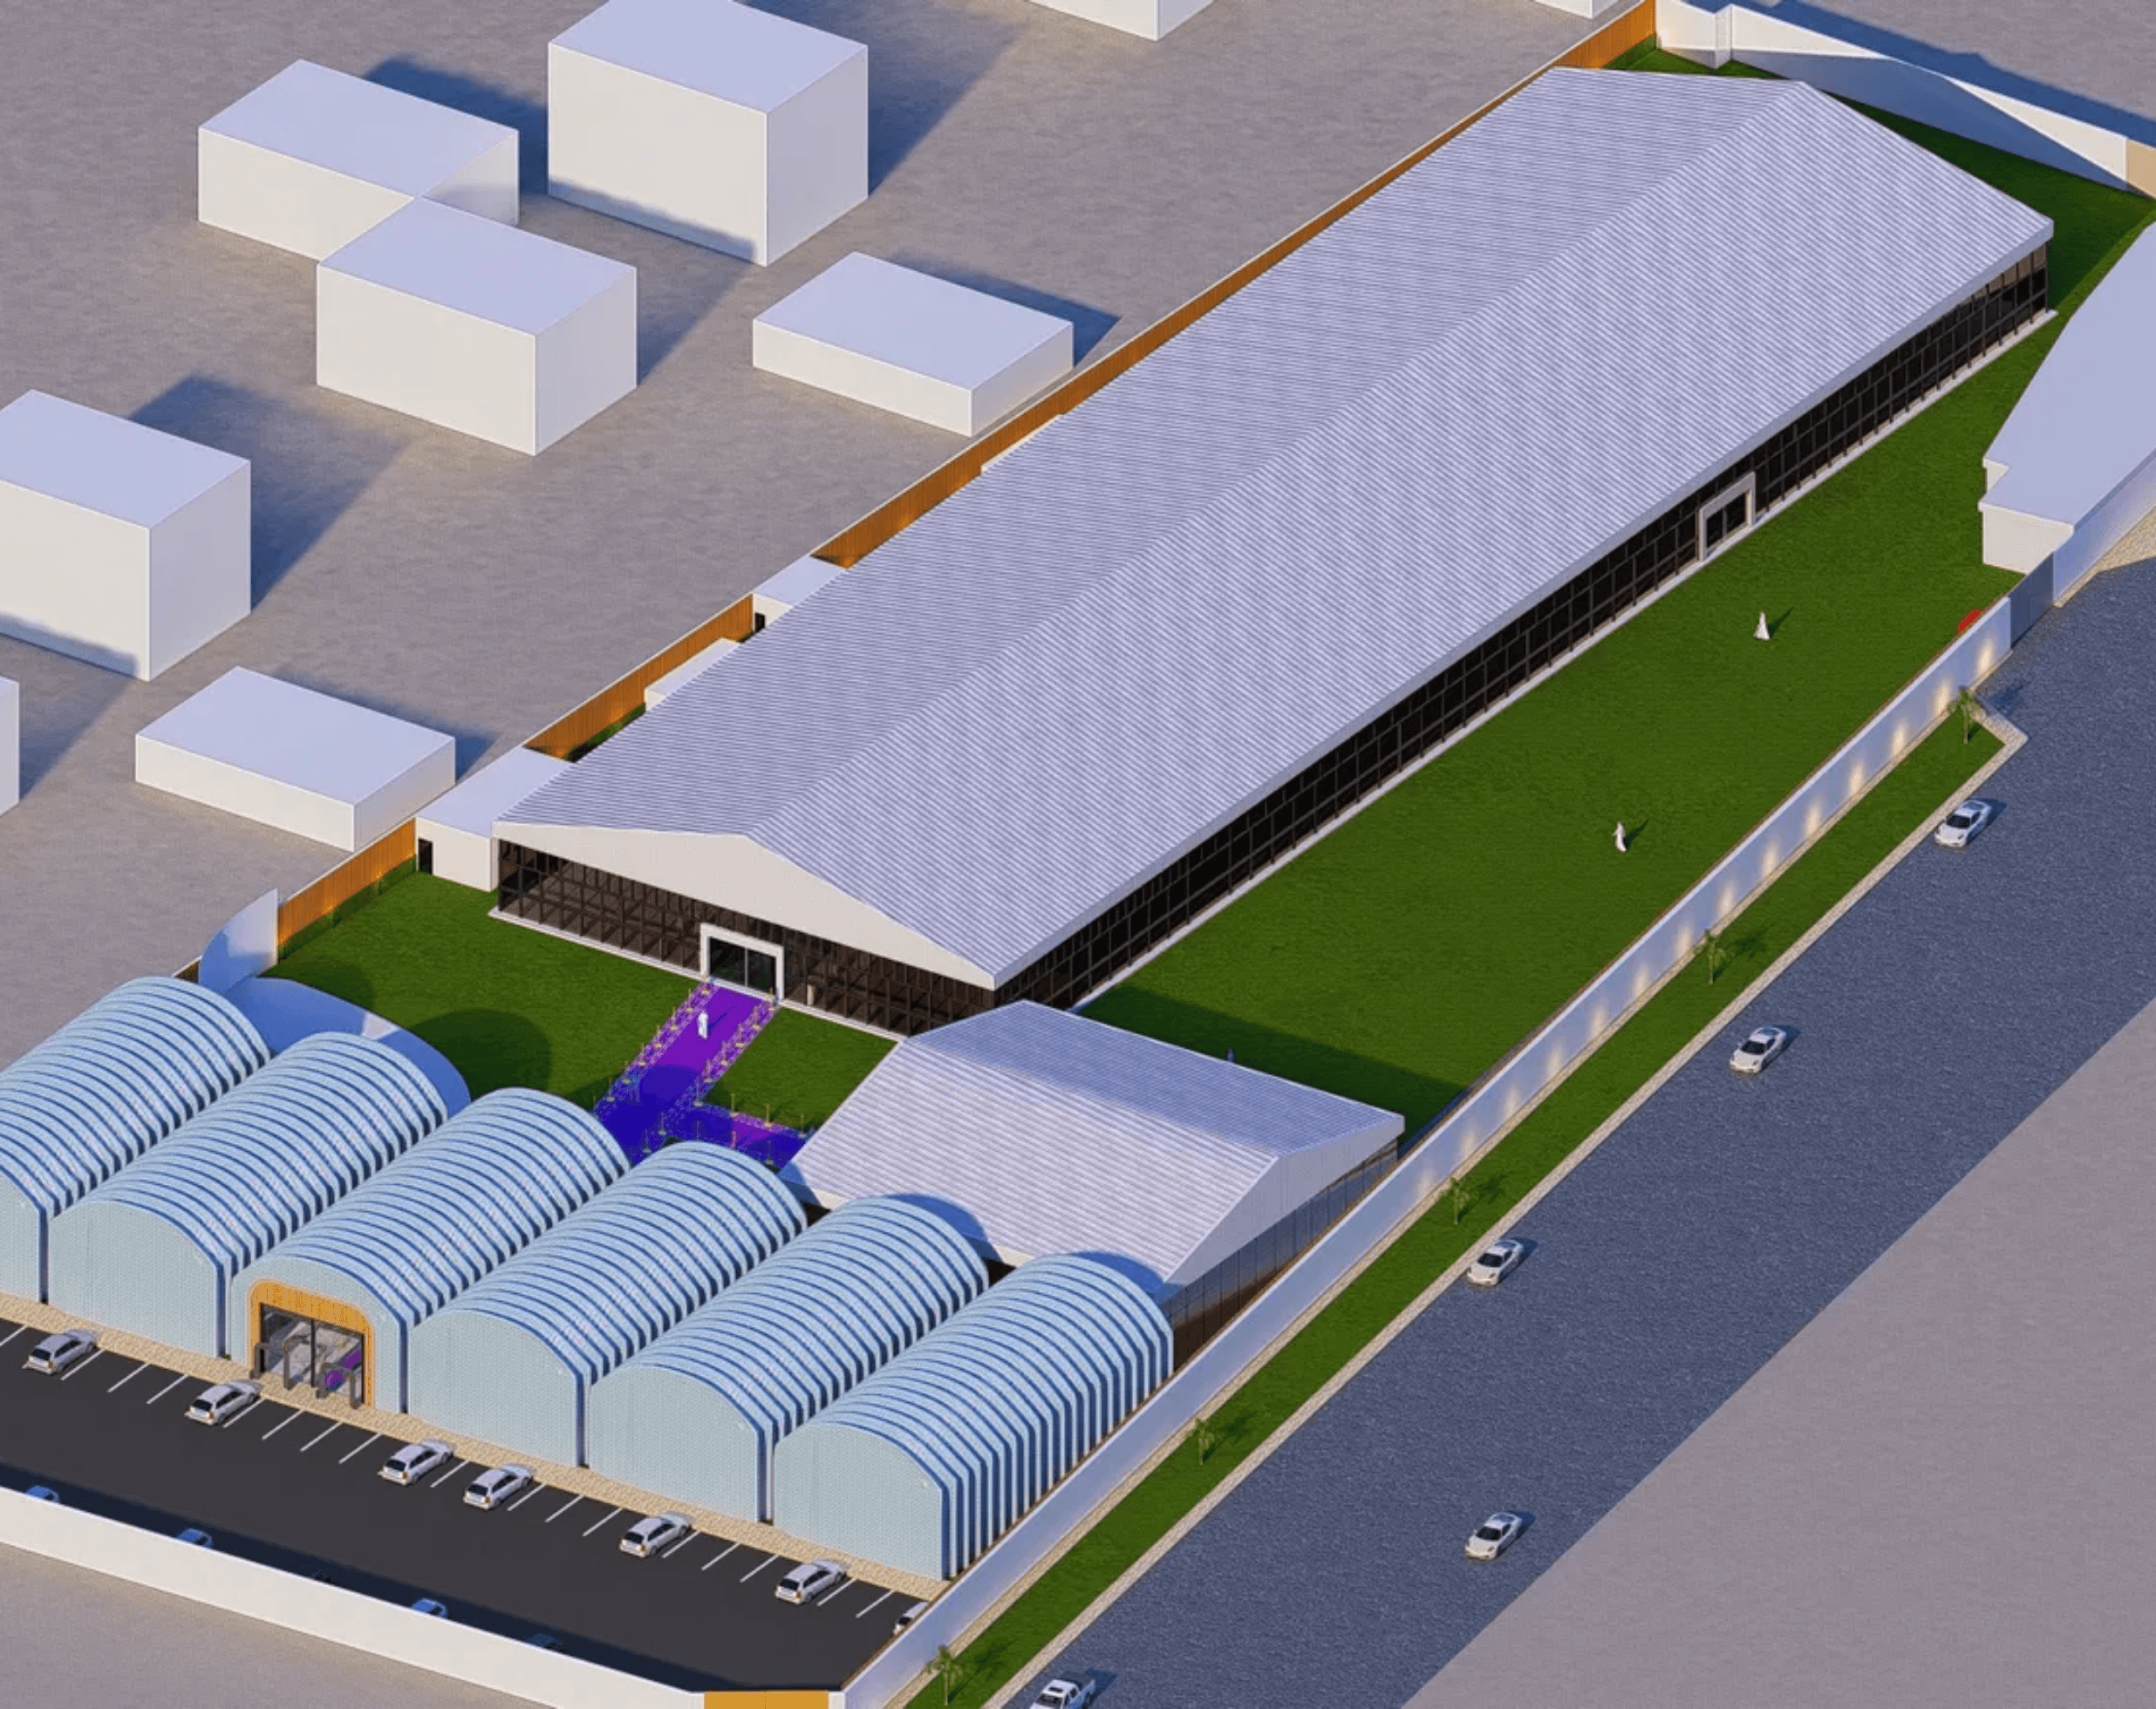




Aerial Overview
Strategic Site Planning for Optimal Event Experience
Integrated Parking
Ample vehicle access and dedicated parking zones for guests and VIPs.
Hangar/Registration Hall
Optimized layout within Riyadh's commercial district for maximum visibility.
VIP Hall
Optimized layout within Riyadh's commercial district for maximum visibility.
Main Hall
Distinct separation of event, administrative, and service areas for operational efficiency.
Outdoor Landscape Area
Beautifully designed outdoor spaces that enhance the venue's aesthetic appeal.

Slide 10


Floor Plan & Layout
Thoughtfully Designed Layout in order to Maximize Functionality
Main Hall Layout
VIP Hall Layout

Slide 11
Hangar / Registration Hall

Slide 12







Event Capabilities & Versatility
The Ideal Venue for Riyadh's Most Demanding Events
Collectors' Exhibitions
Conferences & Business
Trade Shows & Exhibitions
Premium environment for trading card games, automotive collections, fine art, jewlery and memorabilia. Features climate-controlled display areas with museum-quality lighting to protect and showcase valuable assets.
Professional meeting spaces, breakout rooms, and main hall configurations support seminars, workshops, product launches, and corporate gatherings of all sizes with full technical support.
Flexible booth systems and spacious layout accommodate exhibitors and thousands of visitors. Integrated wayfinding and registration areas streamline guest flow for large-scale events.
Cultural Events
Weddings & Celebrations
Hybrid Programming
Dedicated spaces for Ramadan celebrations, cultural exhibitions, community gatherings, and traditional events that honor Riyadh's rich heritage in a sophisticated setting.
Elegant venues for wedding ceremonies, receptions, engagement parties, and family celebrations. Offers customizable décor options and professional catering coordination for intimate or grand events.
Simultaneous events in different zones with dedicated meeting rooms for workshops, seminars, and private gatherings running alongside main programming without interference.

Slide 13







The Dunes Gate Advantage
Why Leading Organizations Choose Dunes Gate
Led by Collectors & Visionaries
Preservation Standards
Prime Riyadh Location
State-of-the-art climate control, security systems, and professional handling protocols preserve the value and integrity of collections and ensure guest safety.
Strategically positioned for accessibility, prestige, and connection to Riyadh's vibrant business and cultural community.
Our board members are accomplished collectors and business leaders, ensuring every decision reflects a deep understanding of event and market needs.
Exclusive Community
Comprehensive Service
Secure Environment
Join a network of VIPs, collectors, businesses, and cultural organizations for collaboration and premium event experiences.
Professional management handles administrative, technical, and hospitality details, allowing you to focus on your event's success.
A premium, professionally managed facility designed to provide complete peace of mind for high-value collections and distinguished guests.
DUNES GATE

Slide 14







Service Offerings & Pricing
Flexible Pricing for Every Event Type and Budget
Event Type
Base Rate
Capacity
Included Services
Full Venue Exhibition
[ .................... ]
Up to 3,000
Climate control, security, registration area, parking
Main Hall Venue Only
[ .................... ]
Up to 2,500
Meeting rooms, AV support, registration, catering coord.
VIP Hall Venue Only
[ .................... ]
Up to 1,000
Booth systems, utilities, registration, wayfinding
Landscape Outdoor Venue (Open Air )
[ .................... ]
Up to 2,000
Flexible spaces, catering coordination, décor support
Private Events
[ .................... ]
Customizable
Full venue customization, dedicated management
Additional Services Available
Event Coordination
Catering Management
Audio/Visual Support
Security Services
Lighting & Décor
Valet Parking
* Pricing available upon consultation. Contact our team for customized quotes.

Slide 15






Our Commitment to Excellence
Dedicated to Creating Unforgettable Experiences
At Dunes Gate, excellence is not a goal—it's our standard. Every decision, every detail, and every interaction reflects our unwavering commitment to quality, integrity, and guest satisfaction.
Service Excellence
Preservation & Security
Community Building
Dedicated teams trained in hospitality and event management ensure every guest receives exceptional treatment.
Industry-leading systems protect collections and guests while maintaining the premium environment our clients expect.
We foster connections between collectors, businesses, and cultural organizations, creating a vibrant community.
Continuous Improvement
Integrity & Reliability
We listen to feedback and continuously enhance our facilities, services, and offerings to exceed expectations.
Our reputation is built on consistent delivery, transparent communication, and unwavering commitment to success.
DUNES GATE

Slide 16



Schedule Your Visit Today
Experience Dunes Gate Firsthand
We invite event organizers, venue operators, and investors to experience the Dunes Gate difference. Our team is ready to discuss your vision and explore how we can support your success.
Contact Information
info@dunesgate.com
www.dunesgate.com
Contact us to arrange a private tour, discuss your event requirements, or explore partnership opportunities. We look forward to welcoming you to Dunes Gate.
DUNES GATE

